Slide 1

Personality

Slide 2
What is personality?
“Personality” derived from Latin word ‘persona’
It remains fairly consistent throughout life.
Popular definition: Social values - a person who is attractive and good looking, is liberal, easily mixes up in social situations and exhibits socially desirable characteristics
Political definition - charismatic, attractive and represents the masses. Presents himself in an impressive manner at a public debate
Biophysical definition - organic internal element of a person, based on physique. Endomorphic being fat and fleshy, Mesomorphic being athletic in build with a lot of muscles, Ectomorphic being thin and bony in build.
Omnibus definition - sum total of all biological, innate dispositions, impulses, tendencies, appetites and instincts of the individual and the acquired dispositions and tendencies acquired by experiences
Integrative definition - consistency in the behaviour of an individual across different situations
Psychological definition - pattern of characteristic thoughts, feelings, emotions, and behaviours that distinguishes one person from another and that persists over time

Slide 3
Personality according to Amparo and Tuazon (1960) can be one of two things:
One’s biggest asset leading to success
One’s heaviest liability leading to failure

Slide 4
Characteristics of personality
Psychophysical systems - traits, emotions, intellect, temperament, character, and motives. All these elements are psychological but they are based in the neurology and endocrinology of the body (physical aspects)
Dynamic organisation - different elements of psychological system are independent but function in an interlocking manner and are subject to change. Changes in the personality of all individuals do come as they enter new roles, responsibilities and circumstances
Consistency - an individual behaves in the same way in different situations and behavioural consistency is found when same situation is repeated across time
Type “A” consistency: situation and behaviour remain same. Ex. a football player is asked to play match against team X and after 10 days he asked to play against the same team.
Type “B” consistency: When the same behaviour is repeated in two different situations. For example, a person appears for an interview before one selection board then he appears for interview for the same job before another board in the final round.
Type “C” consistency: When an individual is asked to behave differently in the same situation. For example, when an actor is asked to imitate different actors.
Type “D” consistency: When a person behaves differently in different situations, influenced by particular type of traits. For example, a person treats his students differently as compared to his colleagues and parents.

Slide 5
Unique adjustment to environment - experiences of every person are unique therefore their reaction to the environment is also unique
Development of personality structure - personality development is the natural quality of a growing organism
Consciousness - develops out of our interaction with the environment. This interaction results in formation of concept of self. Self-concept means who we are and what we stand for.
Potentiality for change
Factors affecting personality
Hereditary factors
Physique and physical health - Traits of physical structure are largely received in inheritance
Endocrine system – our glandular system: Pituitary gland, Adrenal gland, Thyroid gland, Pancreas, Sex gland.
Nervous system – Ex. maldevelopment in hippocampus - deficits in short term memory. a person with more complex and developed nervous system has greater level of intellectual capabilities, and is considered more able to adjust with different situations.
Environmental factors
Social factors - social conditions, social institutions, social acceptance – family, birth order, school, marriage, religion, peer groups, neighbourhood
Cultural factors – child rearing practices, customs, traditions
Economic factors – affects our attitude and perception and consequently our personality

Slide 6
Components of personality
Habits – reactions so often repeated as to become fixed characteristics or tendencies
Attitudes - certain ways of viewing things gained from the environment, changes by the working mind and imagination, and somewhat influenced by the physical environment, particularly emotions
Physical traits – facial appearance, height, weight, physical defects, complexion, strength, health
Mental traits – our ability to control the mind
Emotional traits – individual’s capacity to face different situations in life and still maintain his/her composure
Social traits – individual’s ability to get along with others
Moral and religious traits – standards for a person’s actions and behaviours. Moral traits manifested by conduct. Religious traits guide actions according to beliefs.

Slide 7
Theories of Personality
Psychoanalytic Theory (Sigmund Freud): Personality is shaped by unconscious desires (id, ego, superego).
Trait Theory (Big Five Model): Personality consists of five major traits (OCEAN – Openness, Conscientiousness, Extraversion, Agreeableness, Neuroticism).
Social Learning Theory (Bandura): Personality develops through social interactions and observations.
Humanistic Theory (Carl Rogers, Maslow): Personality is shaped by self-growth and fulfillment.

Slide 8
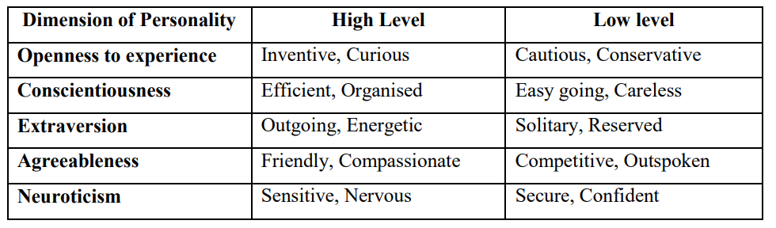
Big Five Personality traits
Openness to Experience
Conscientiousness
Extraversion
Agreeableness
Neuroticism (emotionality)

Slide 9
Big Five Personality traits
Openness to experience- Inventive/Curious vs. Consistent/Cautious
A person's accepted level of imagination and includes multiple experiences like appreciating art, experiencing various emotions and taking up adventurous ideas. Someone who is inventive and curious is likely to have a more active intellectual thought process and multiple/different ways of dealing with a situation or problem.
Conscientiousness- Efficient/ Organized vs. Easy-going/ Careless
A planned and organized approach rather than spontaneity and randomness. A 'structured' person puts great value on order and control which reflects a way of approaching tasks. A 'low structured' person has a more relaxed and casual approach to life.

Slide 10
Big Five Personality traits
Extraversion- Outgoing/Energetic vs. Solitary/Reserved
Implies energy, positive emotions, forcefulness, friendliness, and chattiness.
The extrovert person is sociable, outgoing and attracted to others. However, extroverts can be impulsive and sometimes take risks without weighing the odds.
Contrarily, an introvert is less concerned with others and is more inward-looking. Generally, they have a moderate outlook and a cautious approach to work, but lack excitement. Introverts do not want to be 'in charge' nor do they seek limelight. More often, their attitude is one of a personal challenge (the inner game), rather than competition with others.

Slide 11
Big Five Personality traits
Agreeableness- Friendly/Compassionate vs. Cold/Unkind
The ability to show compassion and co-operation. It is a personality trait that can help you be an amicable person. Giving a cold shoulder to people you encounter on a regular basis may not go down well and may hamper your work and progress in the long and short run.
Neuroticism- Sensitive/Nervous vs. Secure/Confident
It refers to emotional stability, control over emotions and impulses, a tendency for anger, nervousness, despair, or susceptibility. Those with self-confidence are relaxed, optimistic, enjoy responsibility and like to be tested. Under pressure, they react calmly and in an organized way, and have faith in their coping ability. At work/study, they can deal with unexpected events easily, and present their views confidently. Those with low confidence or emotional instability, have difficulty coping with stress. While they can assume responsibility, they may find it to be a strain. They also question their abilities, and show pessimism. At workplace/ study, they like predictability and avoid complex, open-ended situations. It suggests that routine jobs in large, supportive organizations are more likely to suit them.

Slide 12
Personality development depends on
Self-awareness
Clarity of personal and professional goals
Sincere efforts to learn necessary skills and remove weaknesses
Character and conduct
Self-confidence, will-power and self-discipline
Positive thinking and good moral values
Duty, responsibility and accountability
Acceptance of others' feedback, especially criticism

Slide 13
Importance of studying personality
Helps in understanding human behavior and social interactions.
Aids in personal growth
Aids in academic performance (Personality traits can influence how individuals learn and approach academic tasks. For example, conscientiousness is linked to academic achievement, while neuroticism may hinder it)
Motivation to remain engaged in learning
Develop effective time management and organizational skills
Plays a key role in mental health and well-being – self-awareness, resilience, adaptability,
Facilitates effective communication, relationships, emotional intelligence

Slide 14

ABCD personality types – by cardiologists Meyer Friedman and Ray Rosenman 1950s
Type A: Perfectionist, competitive, ambitious, impatient, work-obsessed, achievement-oriented, aggressive, stressed
Type B: Relaxed, even-tempered, flexible, creative, more reflective, adaptable to change, patient, tendency to procrastinate, low stress
Type C: Highly conscientious, perfectionist, detail-oriented struggles to reveal emotions (positive and negative), passive, prone to stress
Type D: Worrying, sad, irritable, distressed, pessimistic, negative self-talk, avoidance of social situations, lack of self-confidence, fear of rejection, appears gloomy, hopeless, socially inhibited

Slide 15
Myers-Briggs Type Indicator (MBTI)
Katharine Cook Briggs and her daughter, Isabel Briggs Myers, created the MBTI. They were not psychologists but writers interested in Carl Jung’s theory of psychological types.
Energy: the amount of energy a person has for socializing. Extroverted (E), Introverted (I),
Perception: how people prefer to get their information. Sensing (S), Intuitive (N)
Decisions: whether a person relies more on Thinking (T) or Feeling (F)
Orientation: how people prefer to live on a scale from Judging (J) to Perceiving (P).

Slide 16
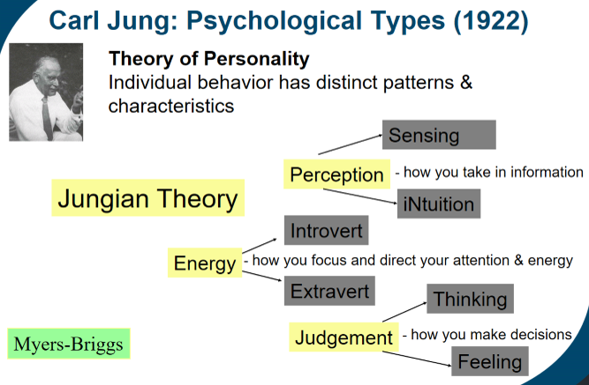

Slide 17
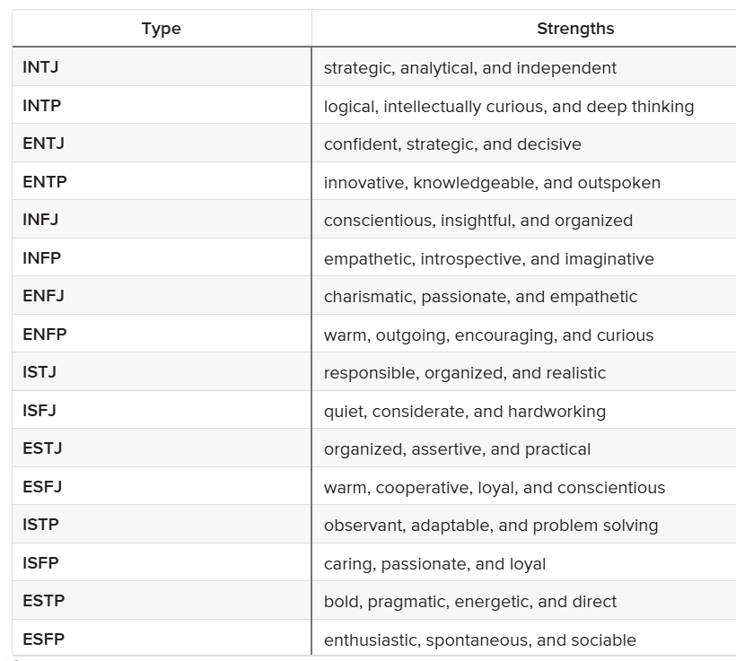

Slide 18

Impact of socialization on the development of an individual’s personality
Learning social norms and values
Socialization teaches individuals the norms, values, and rules of society, which shape their personality. Through interaction with family, peers, and institutions, individuals learn acceptable behaviors, attitudes, and cultural expectations. This helps in the formation of traits like empathy, responsibility, and respect for others.
Role of family
Family is the primary agent of socialization, especially in early childhood. Parents and caregivers shape a child’s emotional and social foundations through their interactions, communication styles, and behaviors. For instance, a supportive and loving environment may lead to the development of a secure and confident personality, while a neglectful environment may result in low self-esteem or insecurity.

Slide 19

Impact of socialization on the development of an individual’s personality
Influence of peer groups
Peer groups influence personality during adolescence, a critical period of identity formation. Through interaction with peers, individuals develop social skills, self-concept, and self-identity. They also experience social comparison, which can influence traits like self-confidence, competitiveness, and assertiveness.
Cultural and societal influences
Culture plays a significant role in shaping personality by providing a framework for interpreting experiences. Cultural beliefs and practices determine what is considered “normal” behavior, influencing traits like individualism or collectivism, independence or dependence, and emotional expression.

Slide 20

Impact of socialization on the development of an individual’s personality
Education and Institutions
Schools and other institutions contribute to personality development by teaching discipline, teamwork, critical thinking, and problem-solving. Education fosters intellectual growth and shapes values like cooperation, responsibility, and leadership, which are essential aspects of personality.
Media and Technology
Media, including television, social media, and the internet, has become a significant agent of socialization, influencing attitudes, beliefs, and behaviors. It can shape personality by exposing individuals to diverse ideas, role models, and lifestyles, impacting their worldview and aspirations.

Slide 21

Impact of socialization on the development of an individual’s personality
Life experiences and Social roles
As individuals grow and take on different roles in society (e.g., student, employee, parent), their personality adapts to these roles. Positive or negative life experiences—such as achievements, failures, or traumas—can lead to changes in self-perception, confidence, and emotional resilience, further influencing personality development.

Slide 22

https://bigfive-test.com/

